Slide 1





Epoch of Reionization:
Magic Planet Imaging,
Grading of Data Quality Metrics
Spring 2014 NASA Space Grant Symposium
University of Arizona, Tucson, Arizona
Michael Busch
Dr. Judd Bowman
Dr. Danny Jacobs
School of Earth and Space Exploration
Arizona State University

Slide 2
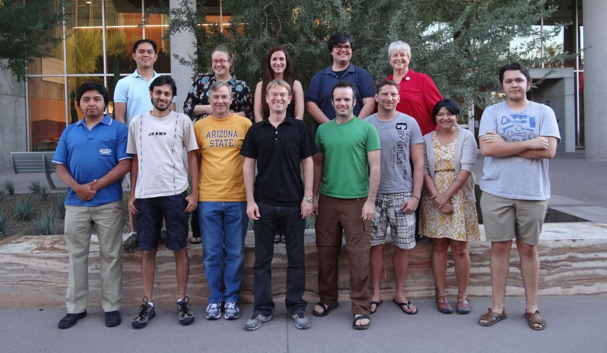
Low-Frequency Cosmology Lab (LoCo)
Led by Professor Judd Bowman
Goal of developing radio instrumentation and conduct astronomical observations to study the evolution of the early Universe and the first stars and galaxies (EoR).
My first project was to aid LoCo’s science outreach component, and second project was to help grade metrics.

Slide 3
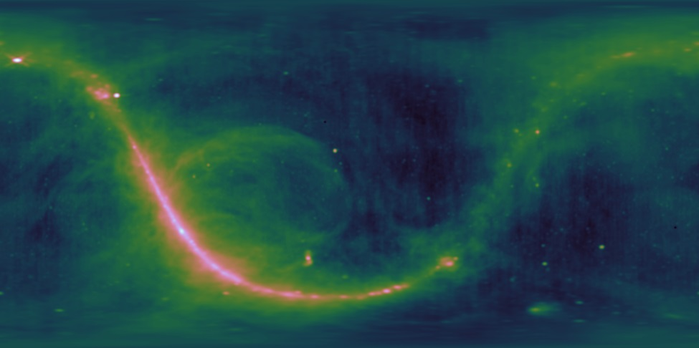
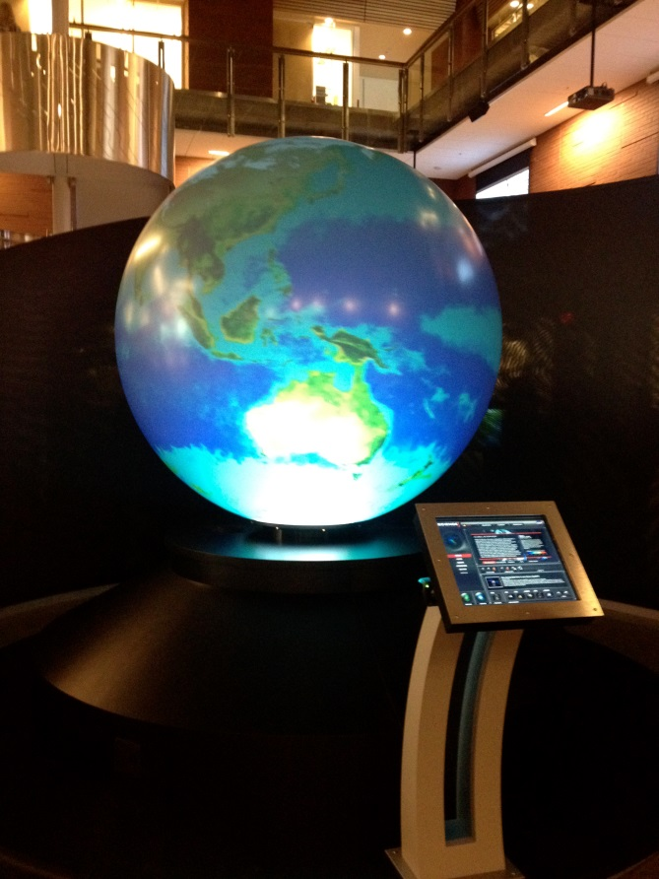
Magic Planet
Sphere that displays data.
Solar system, radio sky, live weather, volcanoes, etc.
Used for outreach, tours of the Gallery of Scientific Exploration (GSE) At ASU.
Goal of enhancing the outreach efforts of the LoCo Lab to the public.
Javascript, HTML. Kiosk functions like a website.

Slide 4
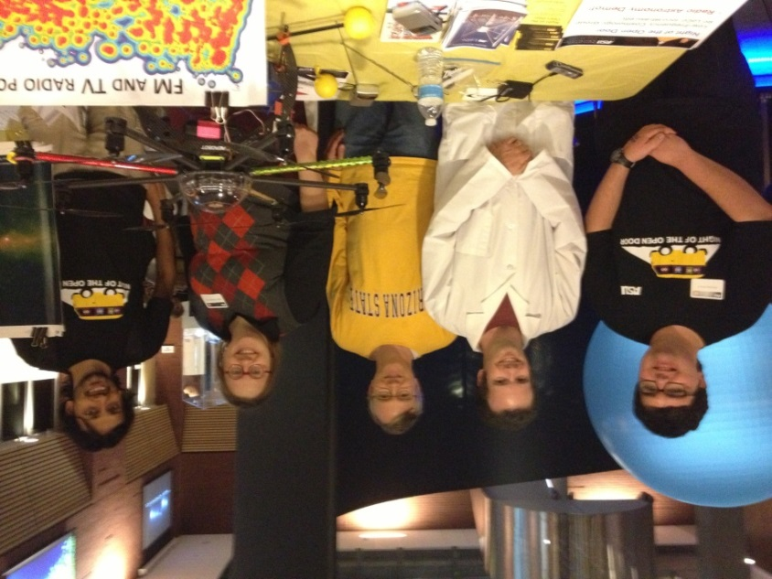
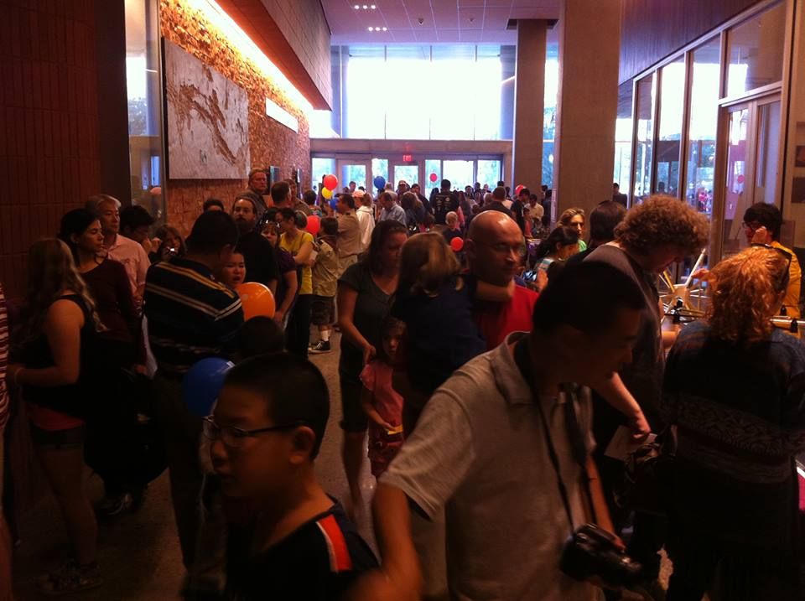
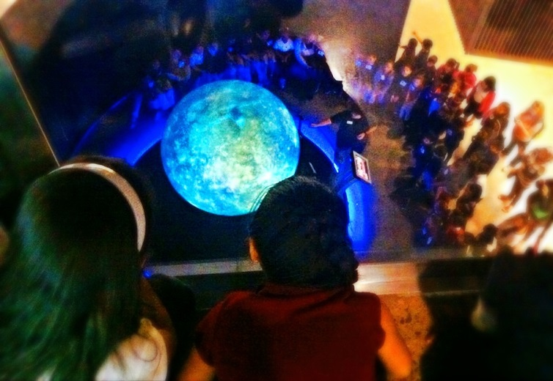
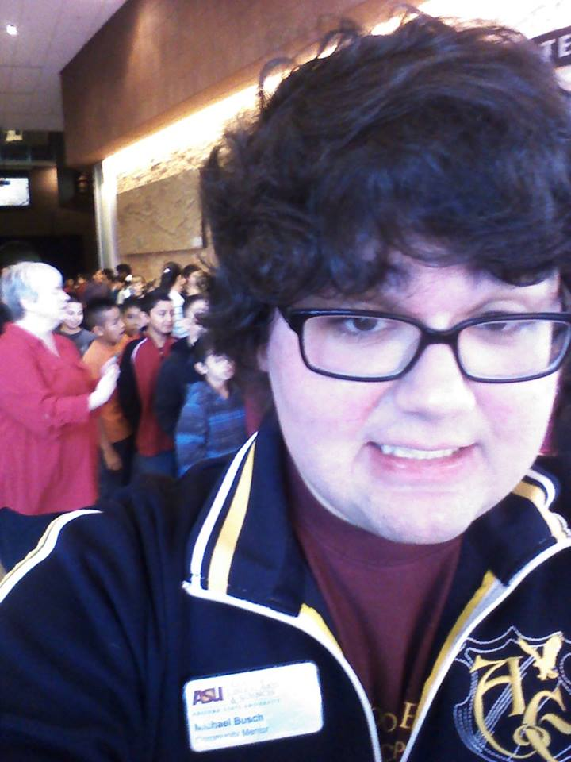
Outreach

Slide 5
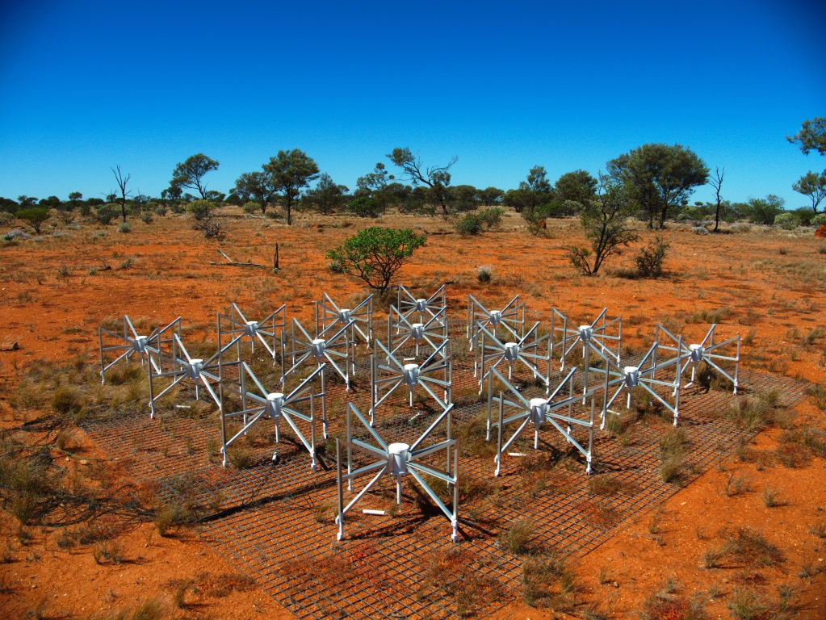
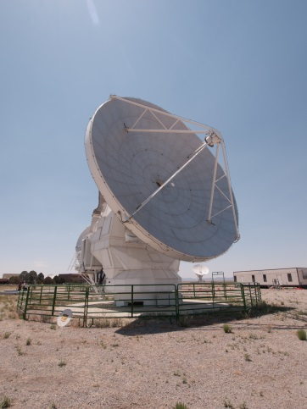
Murchison Widefield Array (MWA)
Radio array in Western Australia, radio quiet environment. Started operation in 2013. ASU is a partner.
Pathfinder (technology, skillset) for Square Kilometer Array (SKA).
Antennas, not parabolic dishes.
2048 Antennas, 128 ‘Tiles’.
To study high redshift universe. Epoch of Reionization (EoR).

Slide 6
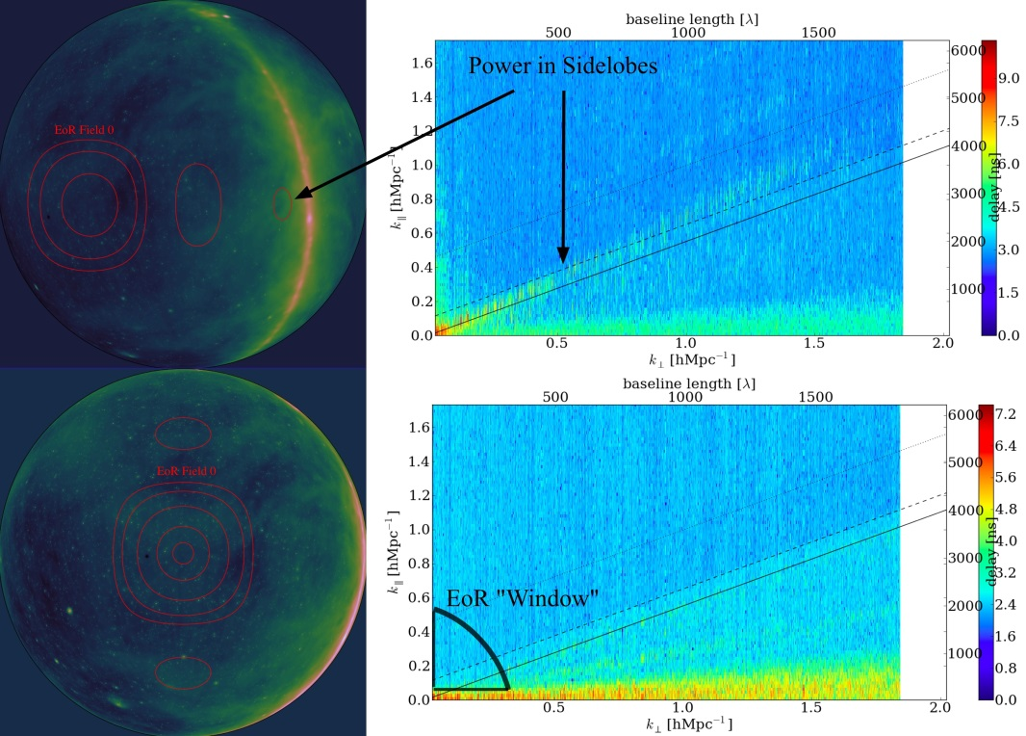
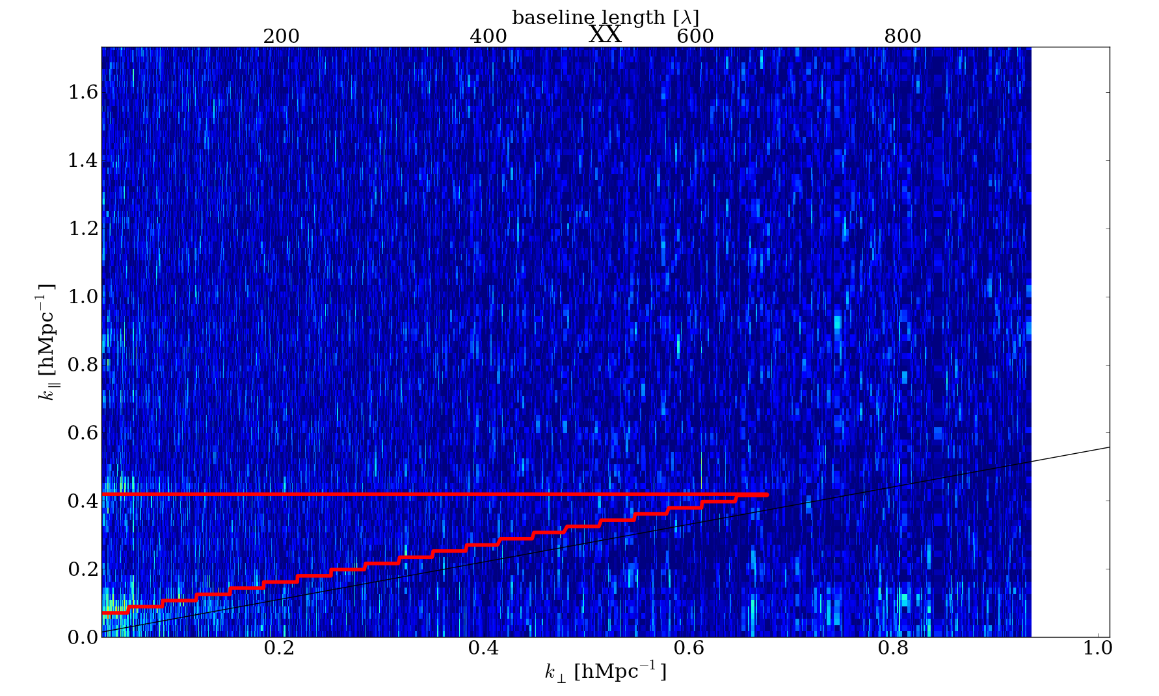
Power Spectra
Goal is to eliminate the foregrounds, and try to detect faint neutral hydrogen emission.
Epoch of Reionization Window
Use algorithm to get rid of noise.
Calibrate algorithm with grading of metrics. Leads to further conclusion about particular algorithm. (In which I say a spectrum is either of ‘good’ or ‘bad’ quality.)

Slide 7
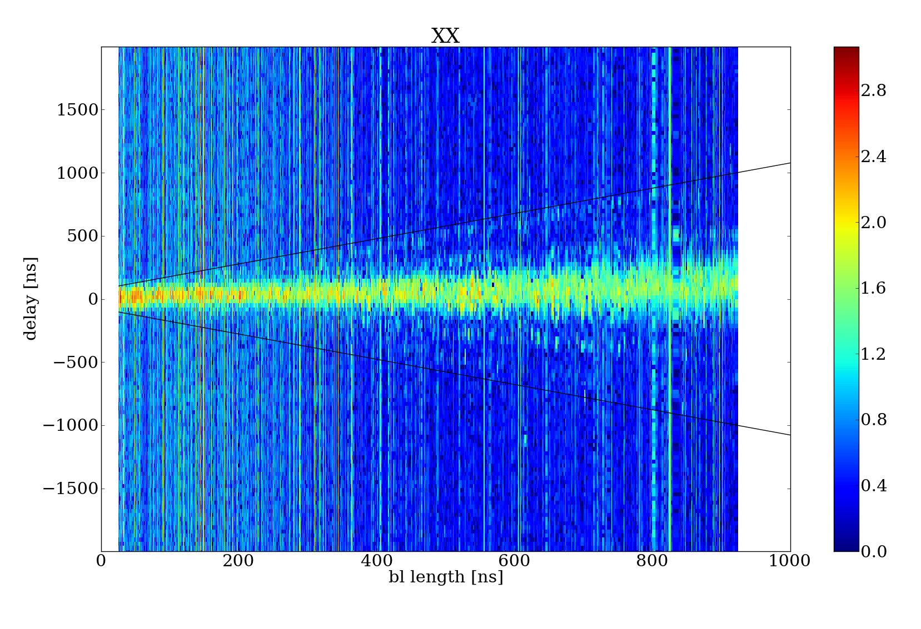
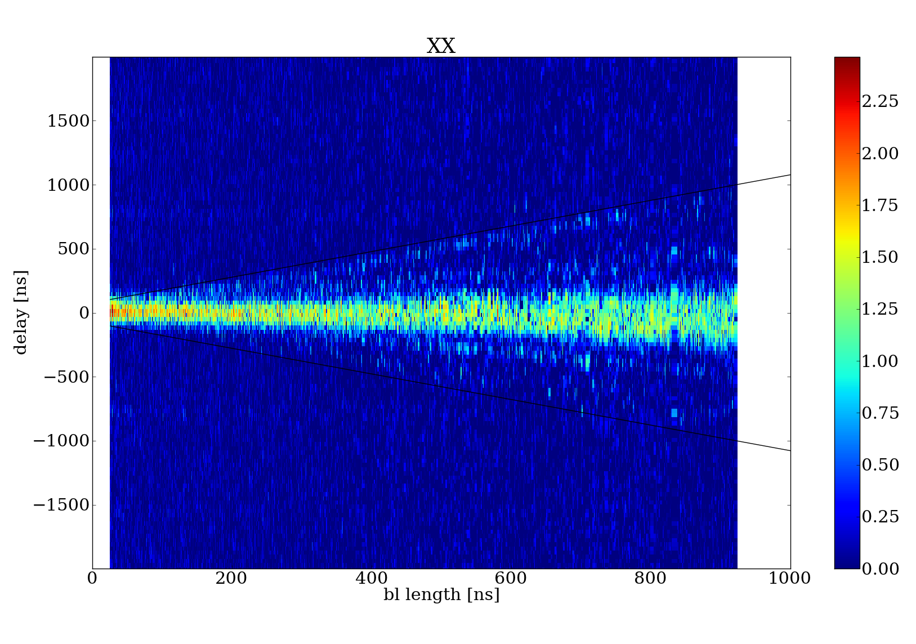
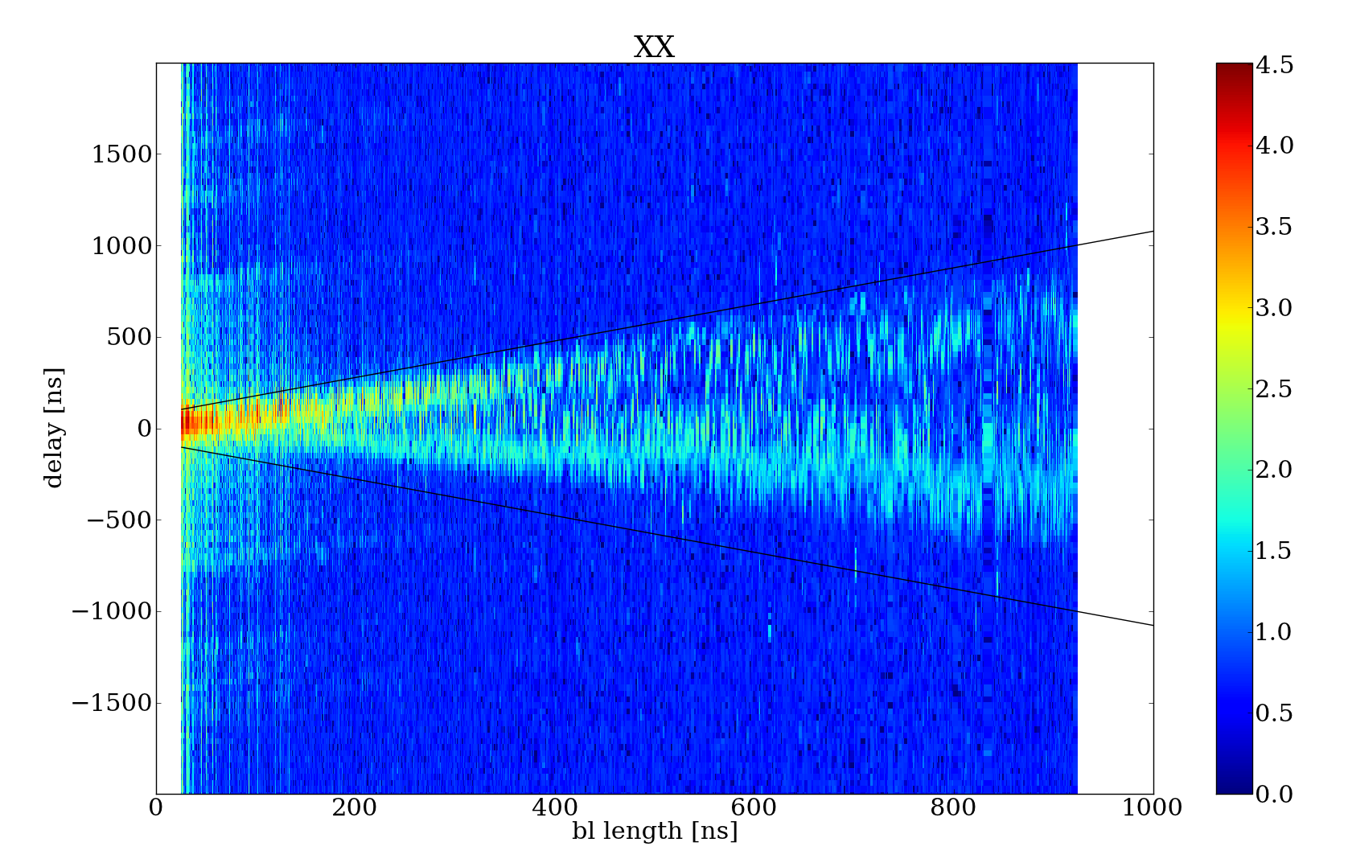
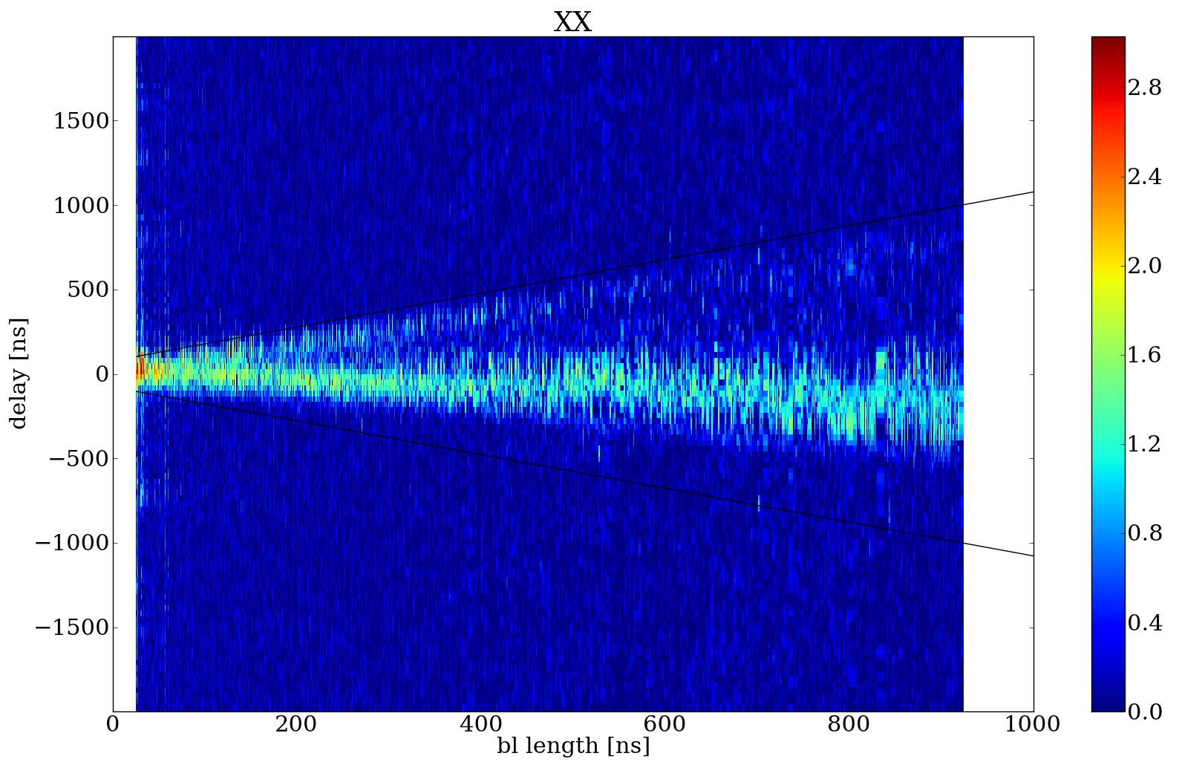
Noisy vs. Good Power Spectra

Slide 8
Results
First algorithm.
  Demonstrated algorithm not properly accounting for phase shift between antennas.
Second algorithm.
  Smoothed out quality hiccups.
  Detected two different types of noise at different times.

Slide 9
Next Steps
Create new algorithms based off visual cues to filter spectra.
Machine learning – Training artificial intelligence to grade mass quantity of power spectra rather than human calibration.
Aid in creation of the MWA data analysis pipeline.

Slide 10
Questions? / Acknowledgements
Thanks to the ASU Space Grant Staff:
  Dr. Thomas Sharp
  Candace Jackson
  Michelle Tanaka
My Mentors:
  Dr. Judd Bowman
  Dr. Danny Jacobs
  Meg Hufford
My Fellow Space Grant Interns
The Arizona Space Grant Consortium
Starbucks

